Slide 1


UNIT 1; All about me
Friends online

Slide 2
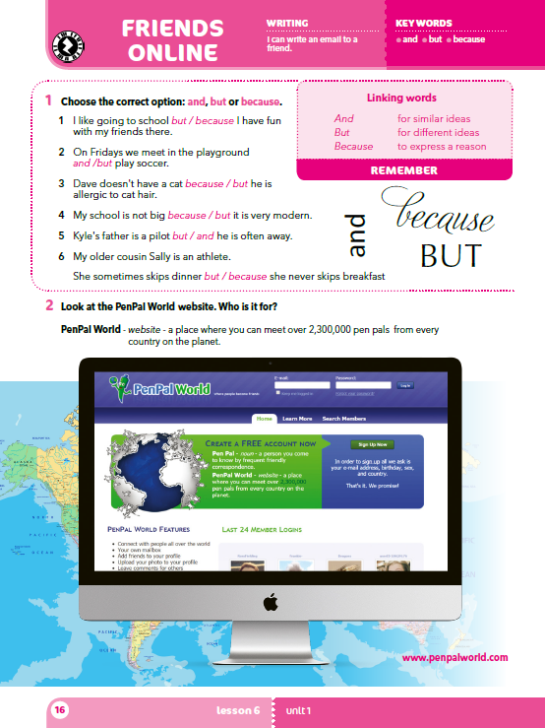
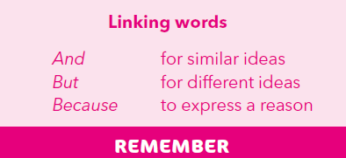
A stuntman/stuntwoman is a dangerous and … job.
I don’t want to be a professional line-stander because …
Being a smokejumper is exciting but also …
za nastavak rečenice istom idejom koristit ćeš veznik AND
za nastavak rečenice suprotnom idejom koristit ćeš veznik BUT
za navođenje razloga koristit ćeš veznik BECAUSE

Slide 3
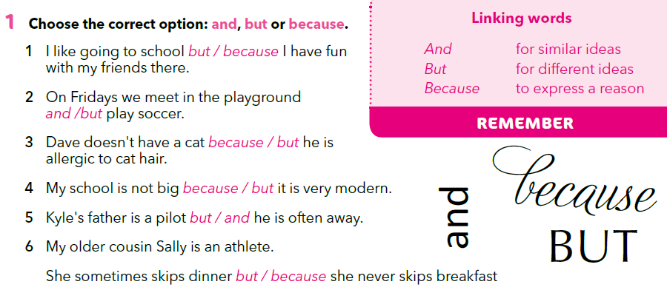

Choose the correct option.
Practise!
https://learningapps.org/7464448

Slide 4
Choose one group and complete the sentences.
Use : tall, fit, good looking, never, often, likes, wizard, hang out
A
I love writing, but…
David knows a lot of people and…
We are reading your text because…
B
I don’t know her, but…
He does it every day because…
I love my dog and…
C
We are 12 and…
School is ok, but…
I am not rude because…
D
You are here and
I don’t know why, but
I like you because…

Slide 5
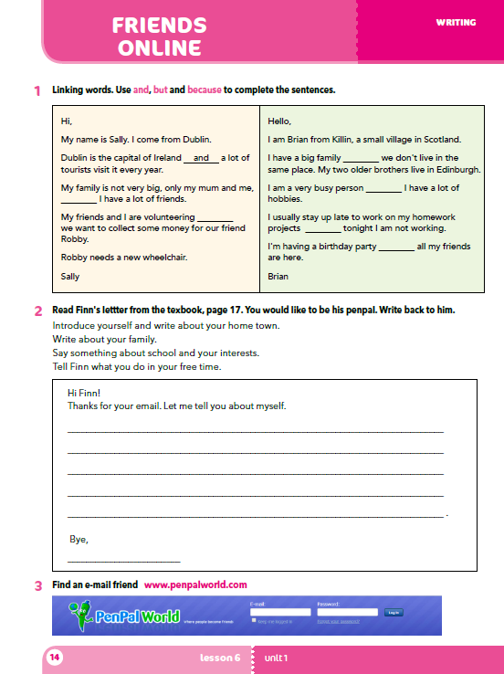
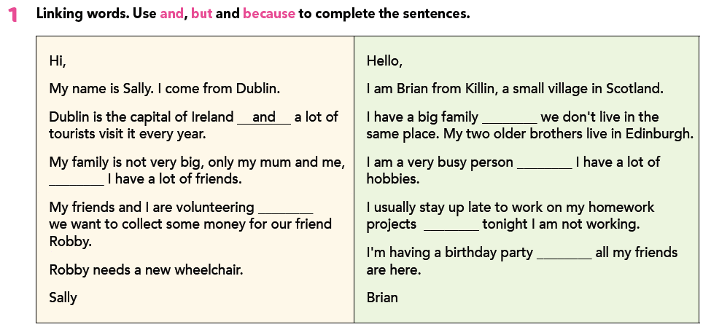
In task 1, you have to use the linking words: and, but, because.
but
and
but
because
but
and

Slide 6
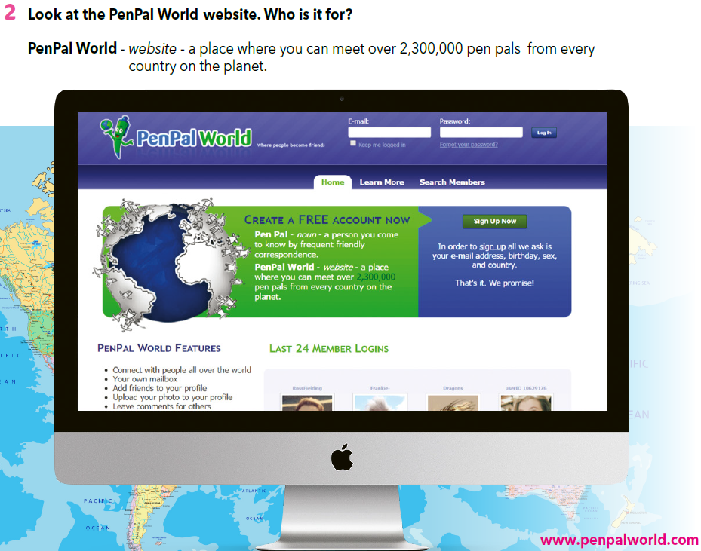
Go back to your books, page 14!
Look at the PenPal World website? Who is it for? Who is a penpal?
PENPAL = prijatelj za dopisivanje
Visit the page!
www.penpalworld.com

Slide 7
Do you sometimes communicate with people by writing to them?
How long are most of your written messages?
How often do you text your parents?
How often do you text your friends?
What do you usually text about?
What is penpalworld.com?
Who is it for?
How many people can you meet there?
Is it safe?
What kind of person would you like to have as a penpal?

Slide 8
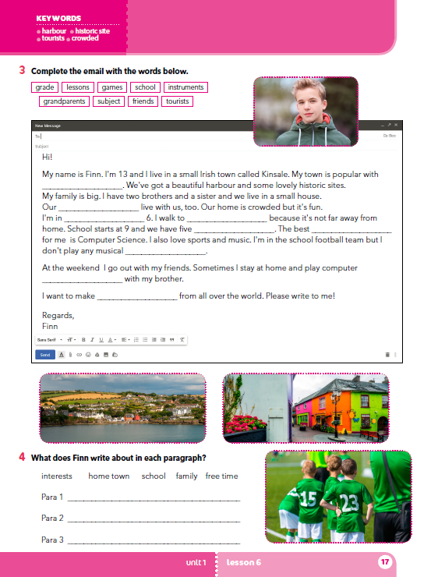
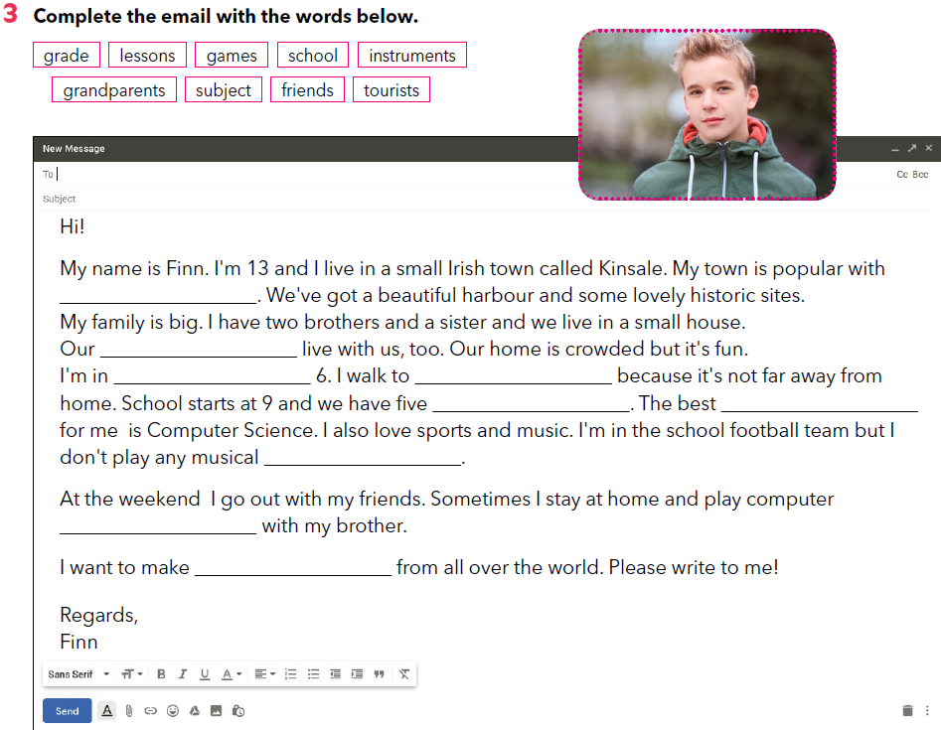
Look at the next page of your books, page 15!
Complete the email with the missing words.
tourists
grandparents
grade
school
lessons
subject
instruments
games
friends

Slide 9
What kind of name is Finn? It’s an Irish name.
Where does Finn live?
He lives in a small Irish town called Kinsale.
Why is Kinsale popular with tourists?
It’s popular because of its beautiful harbour and some lovely historic sites.
Who are the members of Finn’s family?
He has two brothers and a sister, and he lives with his parents and grandparents.
tourists
grandparents
grade
school
lessons
subject
instruments
games
friends

Slide 10

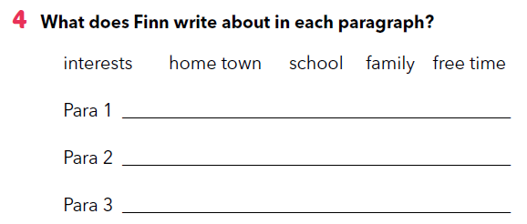
What does Finn write about in each paragraph?
home town, family, school
free time
interests

Slide 11
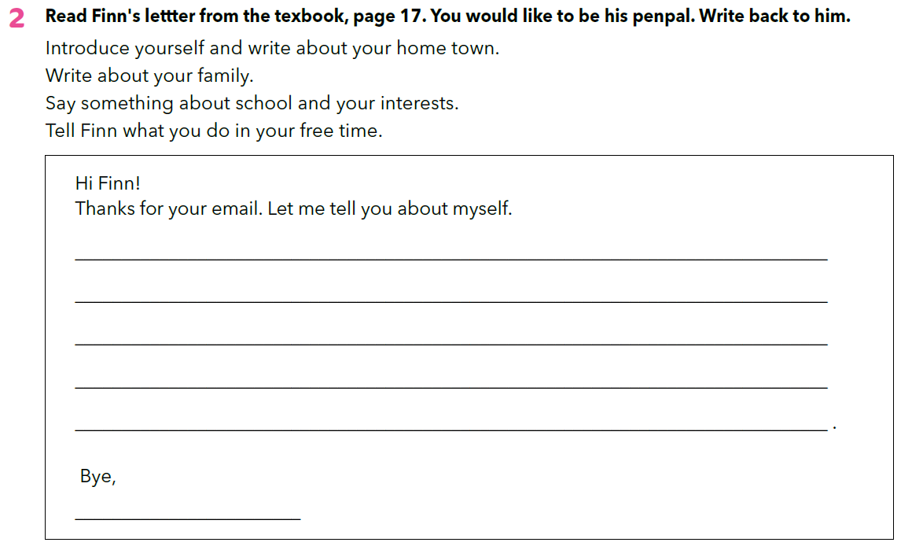
Go back to your exercise book, page 14!
In task 2, write back to Finn.
Napiši pismo jednom vršnjaku na stranici www.penpalworld.com

